Slide 1
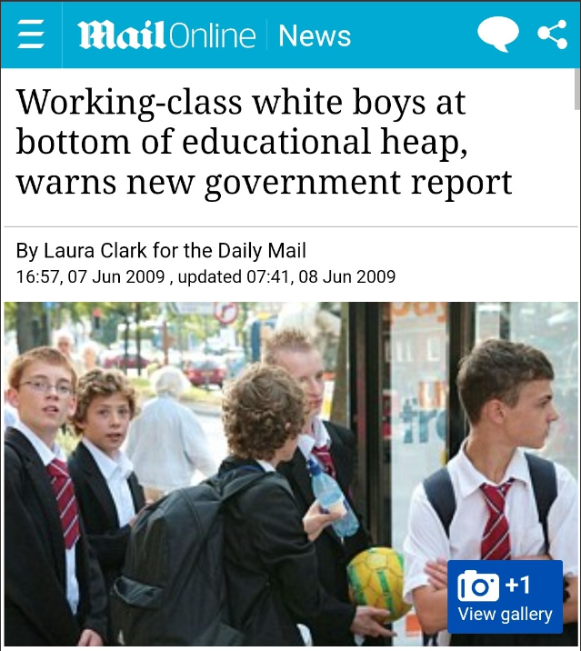
Choice of Topic

Slide 2
Project 1
An Analysis of GCSE Examination Results in England
By
Mohammed Nawaz
Elcin Imanci
Yuk Hang Hui
Kashfi Khalid
Muse Amin
Adel Mahmud

Slide 3
Research Questions
Does gender, ethnicity and social class affect GCSE outcomes, and which has the biggest influence?
Is there a gender difference in the subjects that students take for their GCSEs?
Does the type of school attended affect GCSE outcomes?
Does geographical location affect students GCSE outcomes?
Was there a difference in GCSE outcomes between state and independent schools during COVID?
Are some subjects easier to get a Grade 9 in than others?

Slide 4
Data Source
The data was obtained from:
https://www.gov.uk/government/collections/statistics-gcses-key-stage-4
Data files
Guidance

Slide 5
Before we start ……

Slide 6
Measures of Success in Education
Attainment 8
The average measure of an individual student’s progress across their 8 best performing subjects which fall into three buckets.
Progress 8
This is a measure of students’ progress across 8 subjects. This is a value added measure whereby students’ results are compared to students who had the same prior attainment score at KS2. It uses the same buckets as Attainment 8.

Slide 7
Buckets for Subjects
Bucket 1: English and Maths
The score for Maths and English will be double weighted.
Bucket 2: Three highest Ebacc subjects, which are as follows:
• Separate Sciences
• Core & Additional Sciences
• Computer Science
• History
• Geography
• Languages
Bucket 3: Three ‘other’ subjects in which students have received their highest grades.

Slide 8
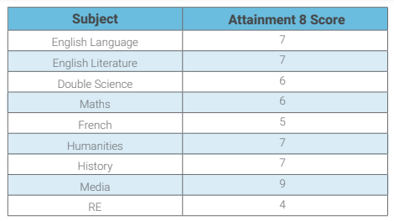
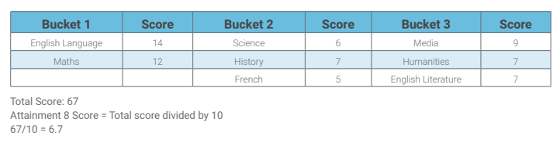
An Example
Amy achieved the following grades in her examinations:
GCSEs are graded from 1 to 9

Slide 9
Calculating a student’s Progress 8 score
Amy’s Attainment 8 score = 67
Amy’s estimated Attainment 8 score = 59.95
Progress 8 score = (67 – 59.95) / 10 = 0.71

Slide 10
Q1 Analysis
What effect do gender, ethnicity and social class have on GCSE outcomes?

Slide 11
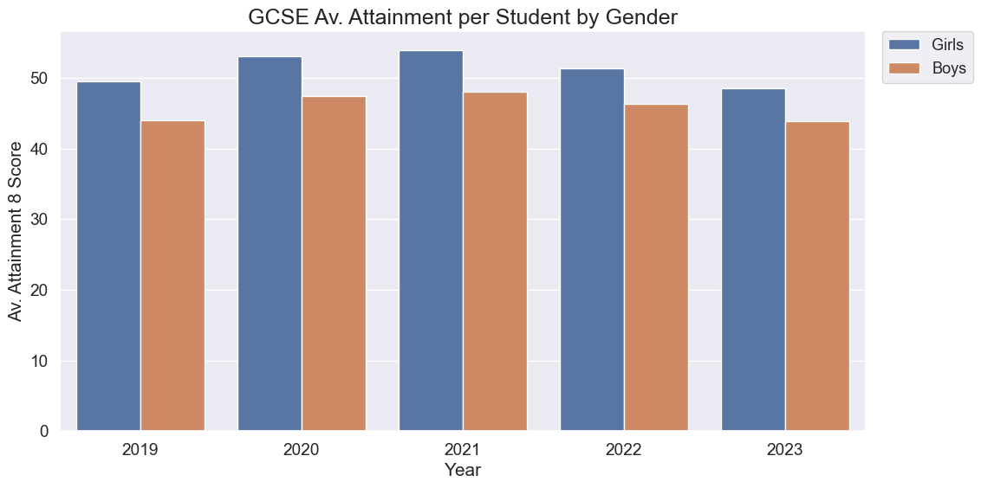
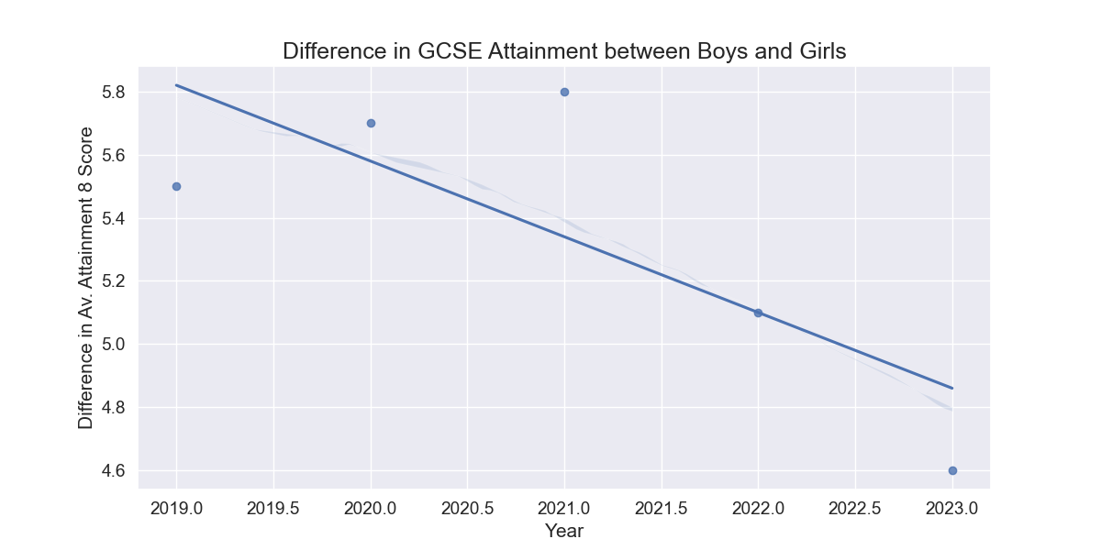
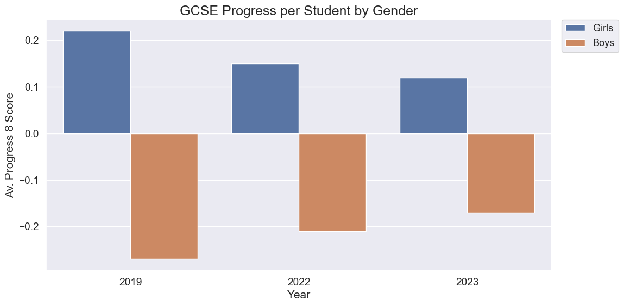
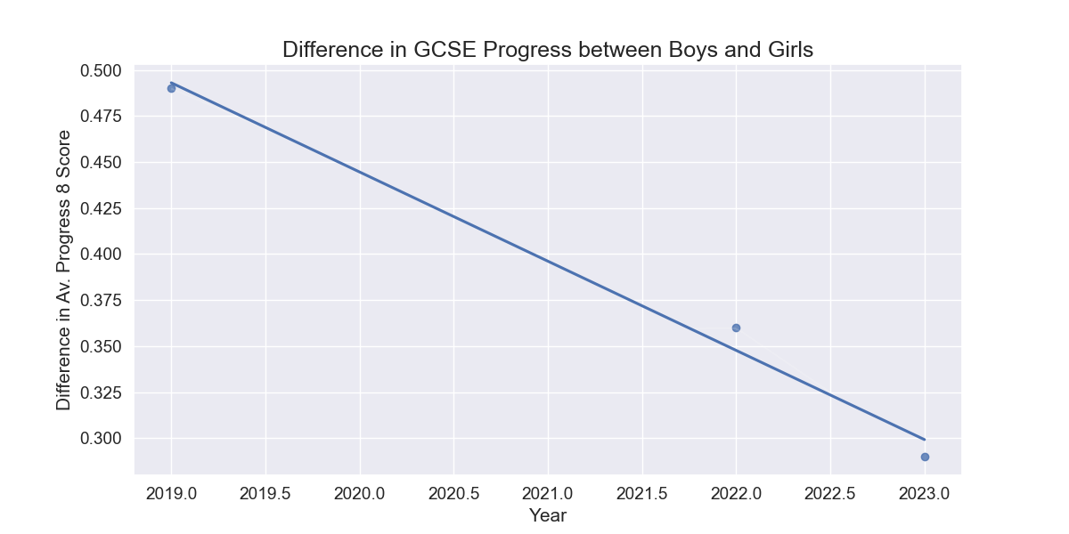
Gender Analysis

Slide 12
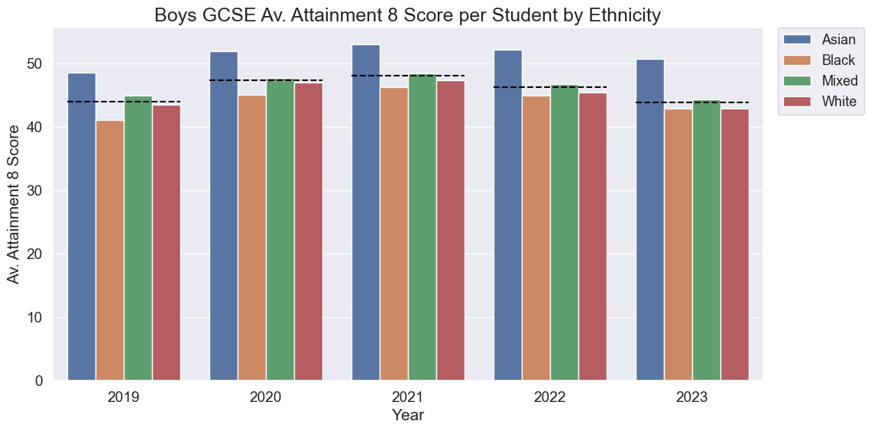
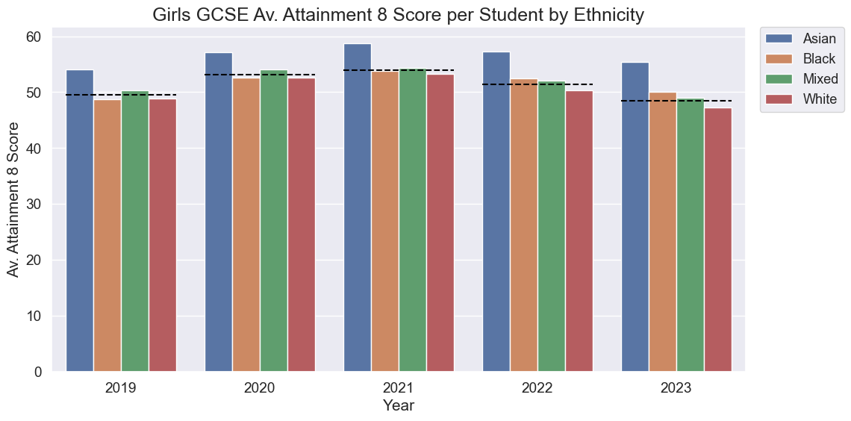
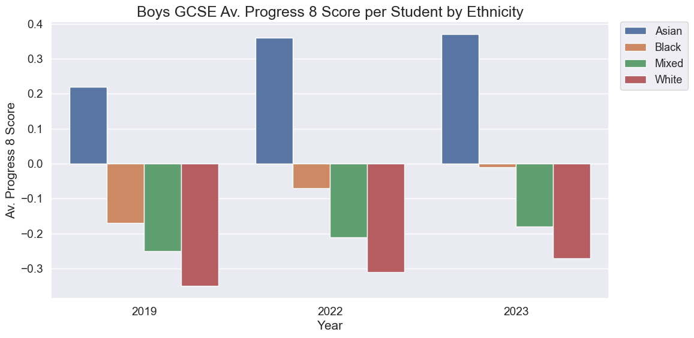
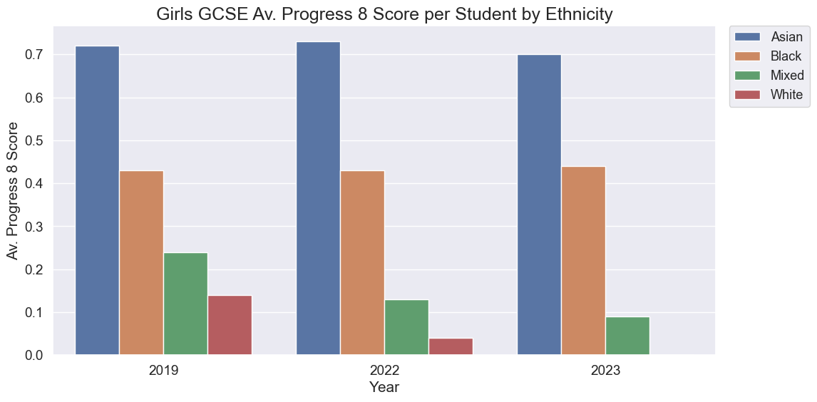
Ethnicity Analysis

Slide 13
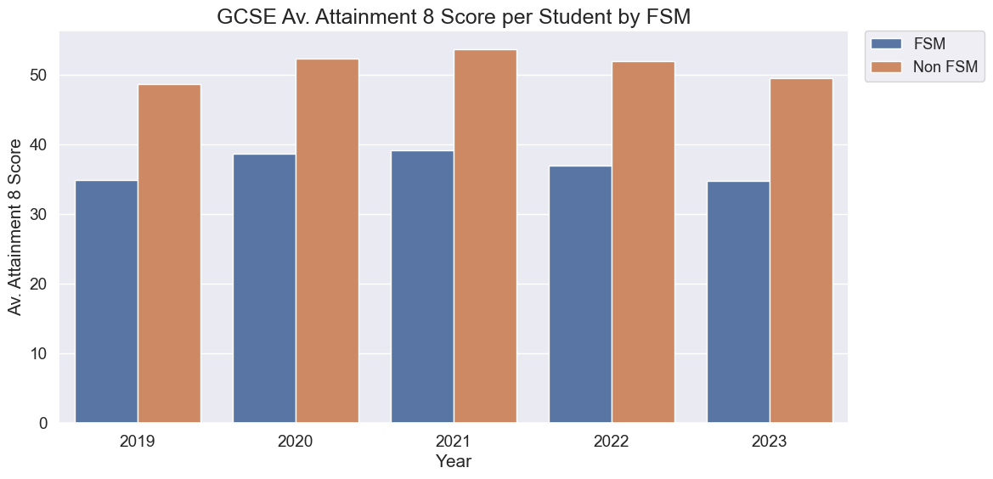
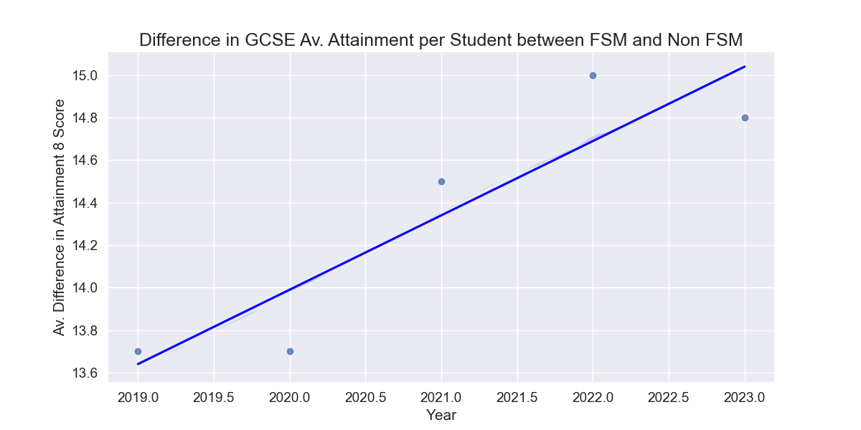
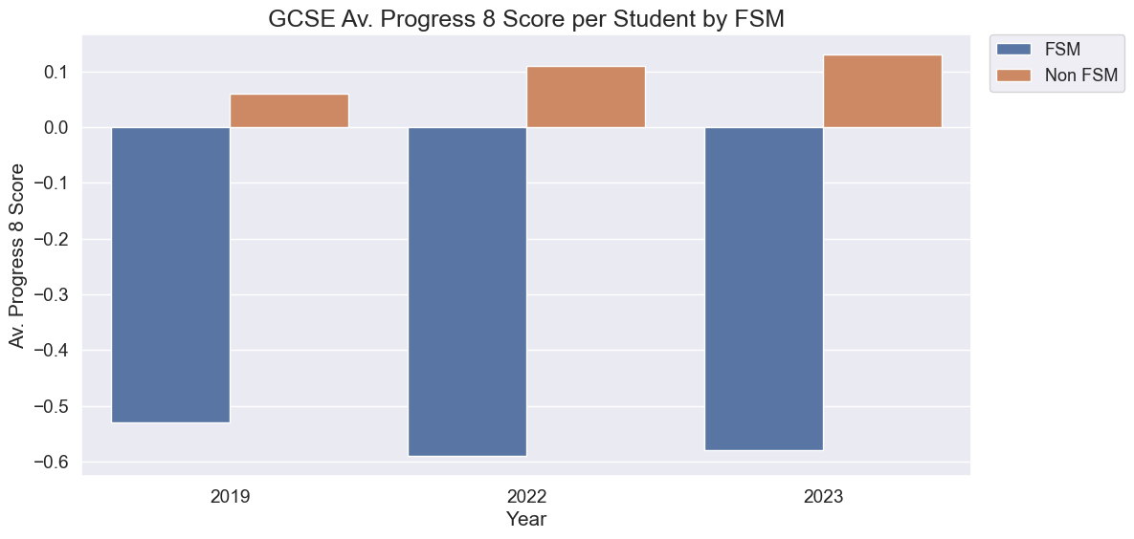
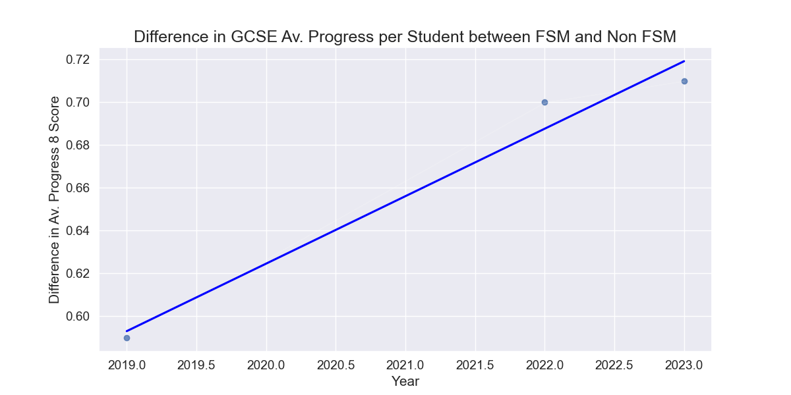
Social Class Analysis

Slide 14
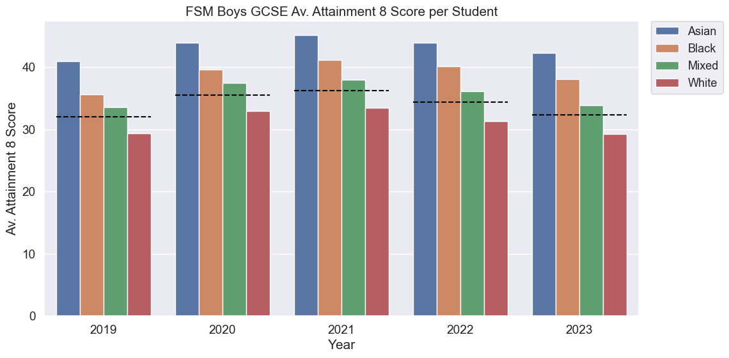
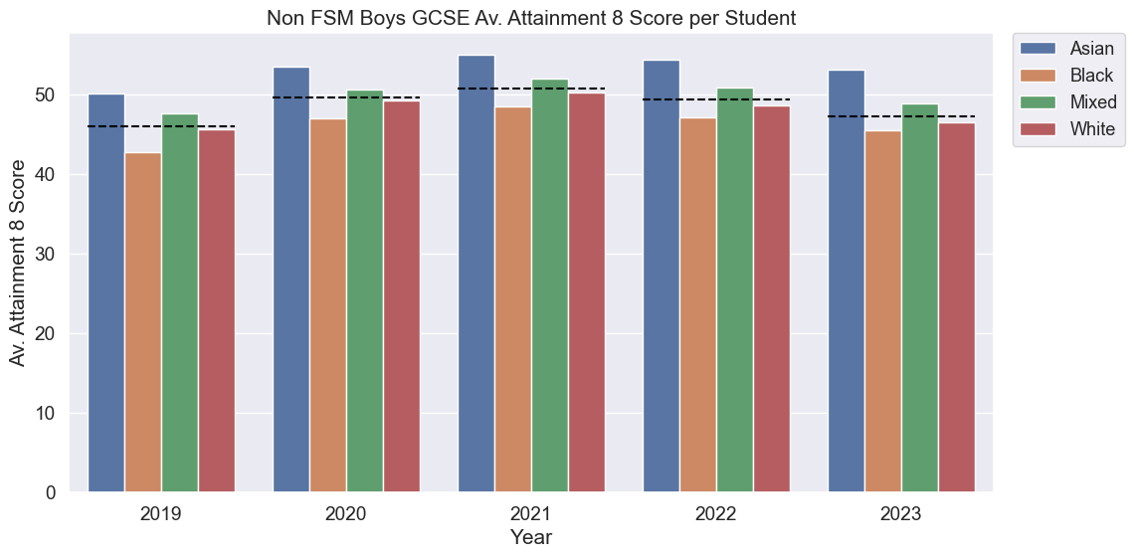
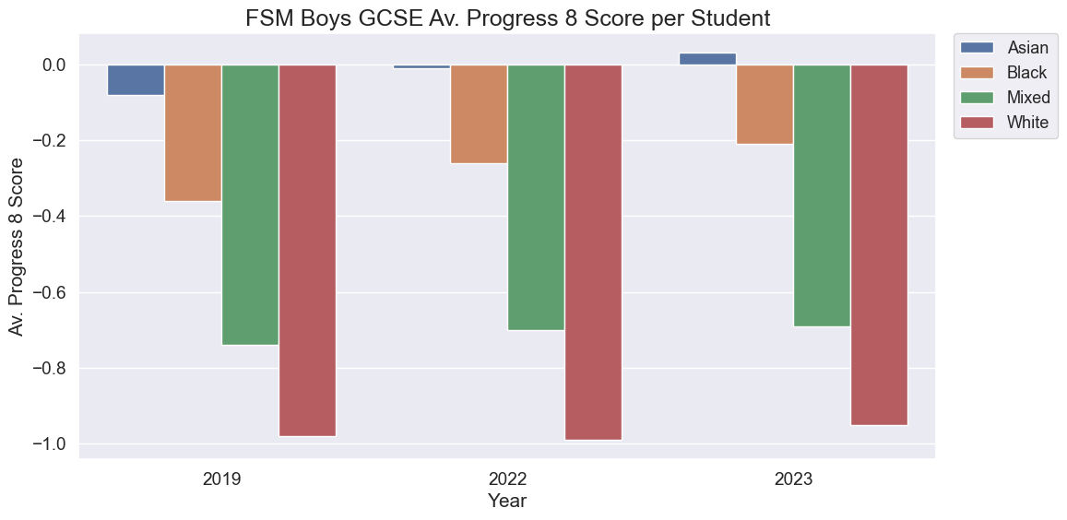
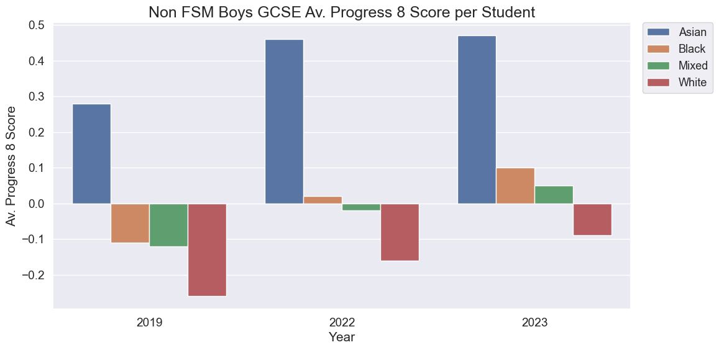
Social Class and Ethnicity Analysis

Slide 15
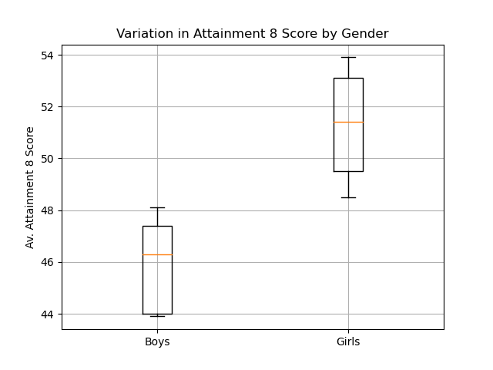
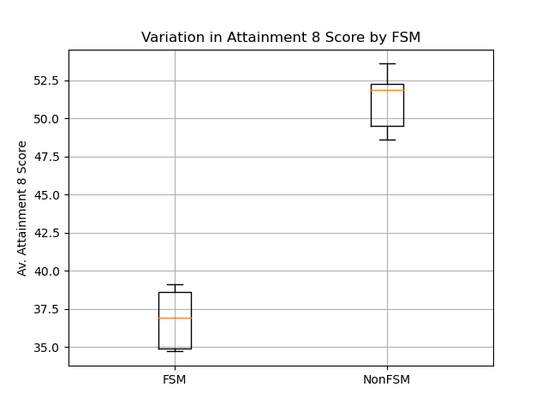
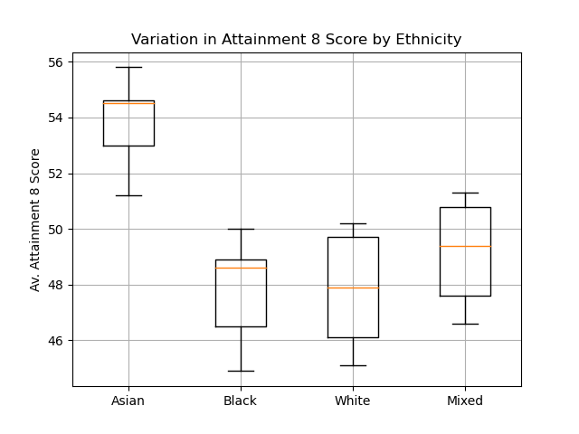
Box Plots

Slide 16
Annova Test on Gender, Ethnicity and Class
 | p-value
Gender | 0.004
Ethnicity | 0.0006
Free school meals | 4.0 x 10⁶

Slide 17
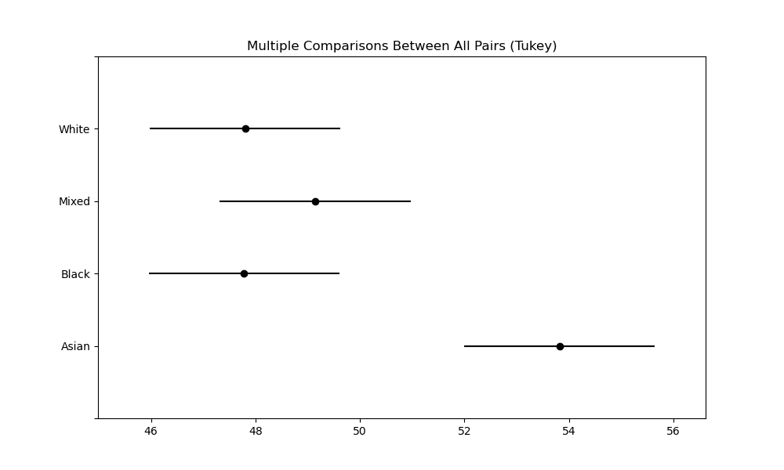
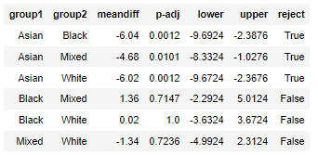
Tukey Test on Gender, Ethnicity and Class

Slide 18
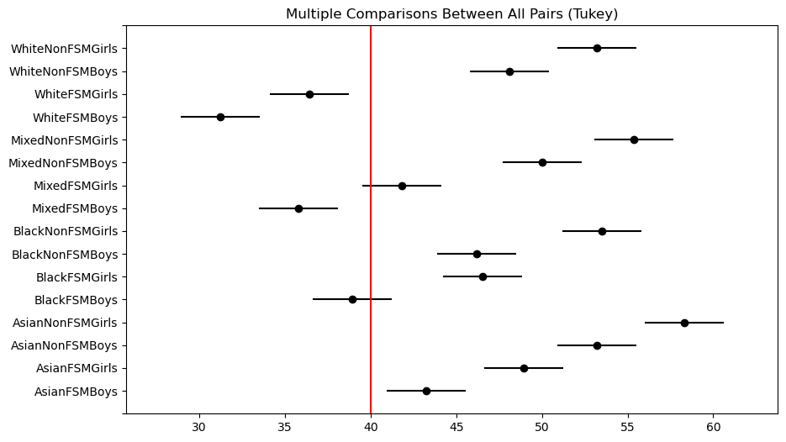
Tukey Test on All Combinations
Link

Slide 19
Q1. Summary
Gender, ethnicity and social class all have an effect on GCSE outcomes but the largest effect is due to social class.

Slide 20
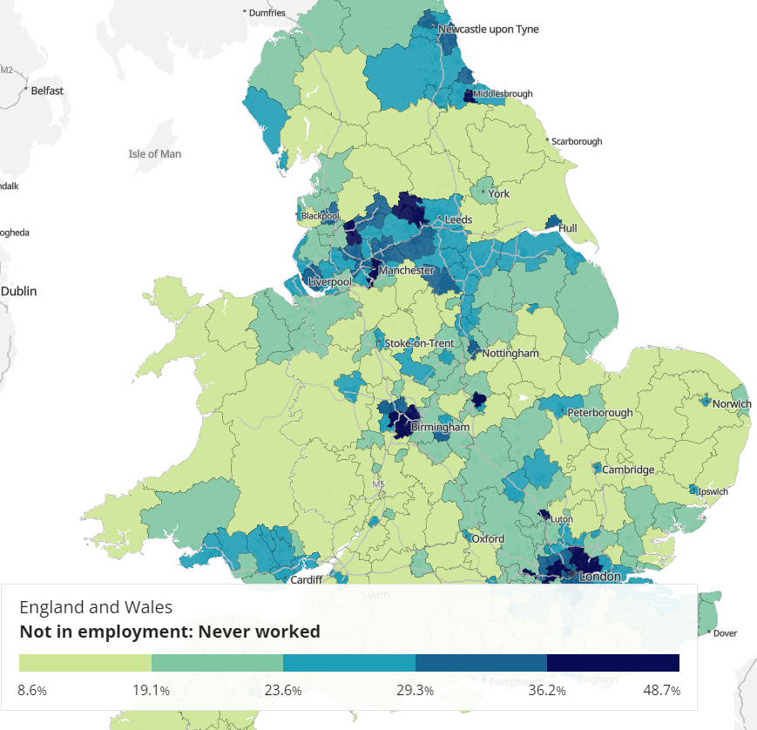
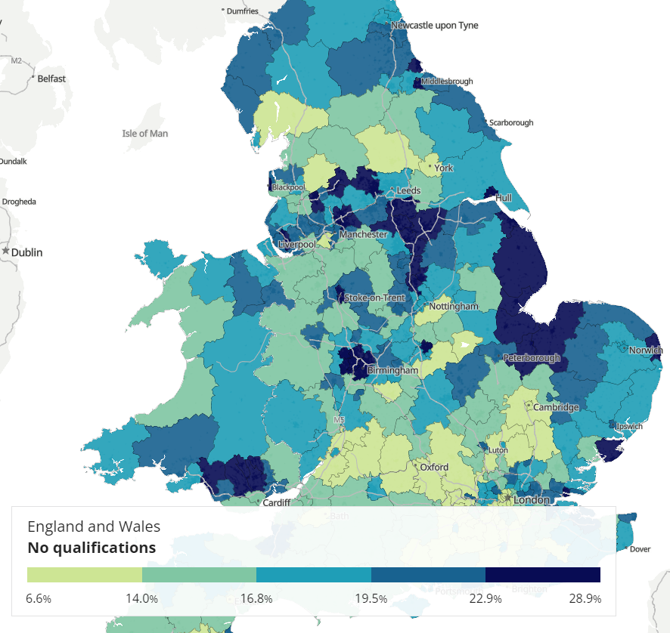

Slide 21
Is there a gender difference in the subjects that students take for their GCSEs?
Q2 Analysis

Slide 22
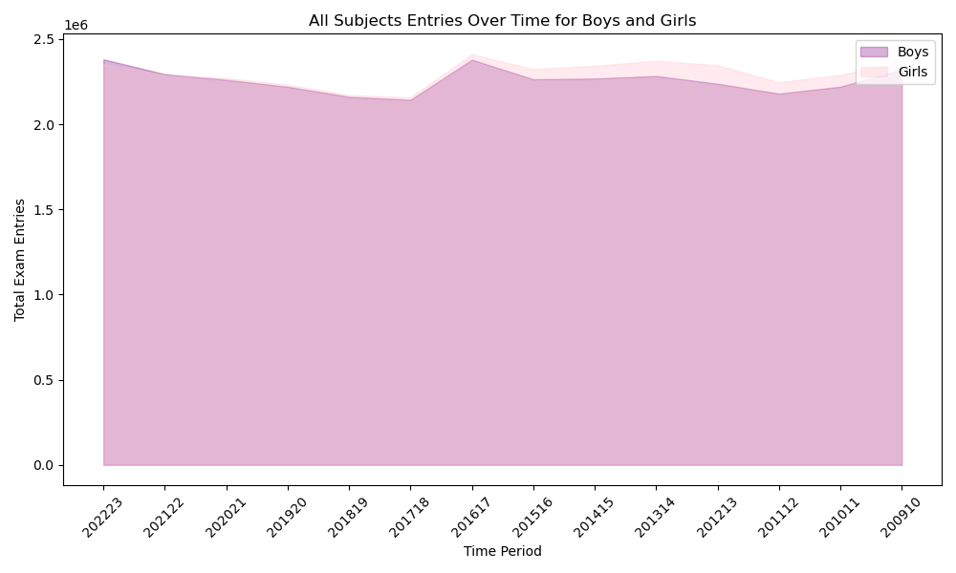
Summary Statistics:
Boys Entries Girls Entries
count 1.400000e+01 1.400000e+01
mean 2.258654e+06 2.298904e+06
std 7.219183e+04 7.617288e+04
min 2.143924e+06 2.158193e+06
25% 2.220532e+06 2.253191e+06
50% 2.262859e+06 2.307224e+06
75% 2.291867e+06 2.352804e+06
max 2.381705e+06 2.411165e+06
Correlation between Boys and Girls Entries: 0.8603432165499106
According to the statistical results shown in the table;
-Both boys' and girls' exam entries have similar mean values and standard deviations, signifying a comparable average and spread of entries over the time periods.
-The strong positive correlation (0.86) between boys' and girls' entries suggests that when there's an increase in boys' exam entries over time, there's a corresponding increase in girls' entries as well. This relationship indicates a consistent trend in both genders' exam participation across the years.
-Overall, we can see that the data suggests a parallel trend in exam entries for boys and girls over the studied time periods, with a strong positive correlation in their participation.

Slide 23
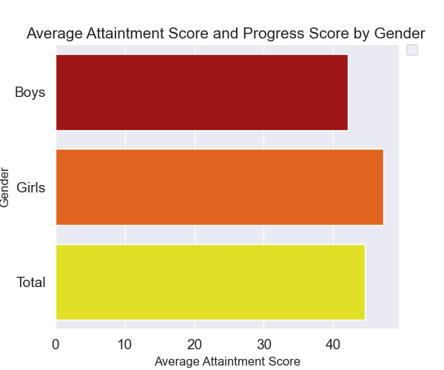
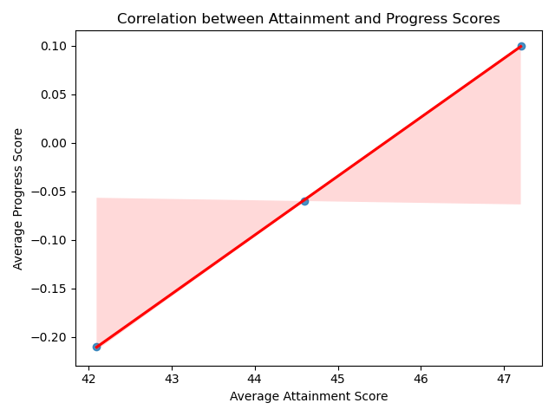
Girls, on average, seem to perform better in attaining GCSE scores compared to boys. This is evident from both the individual gender scores and the overall average.
Similarly, girls appear to have better progress scores on average compared to boys. Progress scores can indicate the improvement or growth from prior assessments, where positive scores denote improvement.
Across both attainment and progress scores, girls seem to outperform boys, reflecting higher average scores in both metrics.
The correlation coefficient and scatter plot can provide insights into how Attainment 8 and Progress 8 scores relate.
A positive correlation suggests that students who perform well in Attainment 8 tend to have better Progress 8 scores indicating good progress from primary to secondary school.

Slide 24
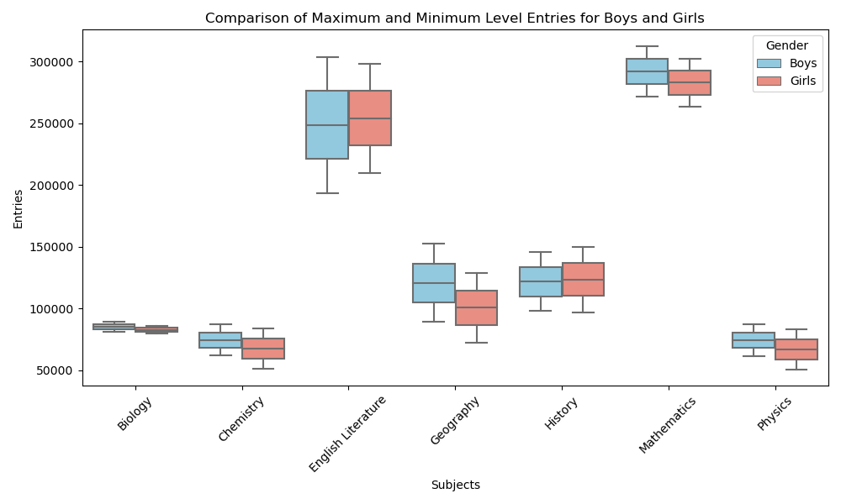
Chi-Square Statistic had been made to determine if there's an association between gender and subject choice?
Chi-Square Statistic: 300.1920674311997
P-value: 7.440737048316971e-62
Significant Association: The small p-value (much less than the commonly used significance level of 0.05) strongly suggests a significant association between gender and subject choice for GCSE exams based on the provided data.
Conclusion: From these results, it appears that there is a statistically significant relationship between the subjects chosen (Biology, Chemistry, English Literature, Geography, History, Mathematics, and Physics) and gender (Boys and Girls) for GCSE exams.

Slide 25
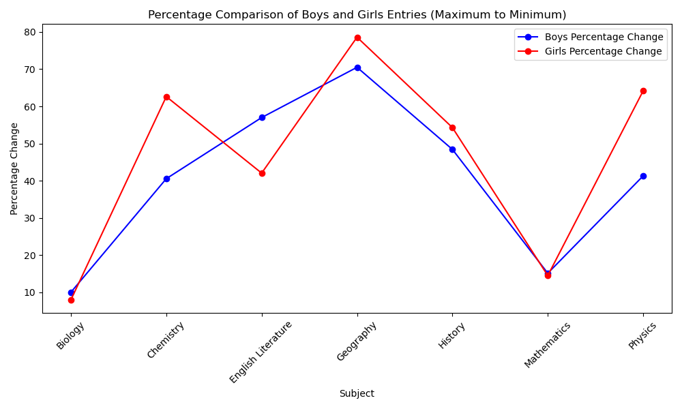
Chi-Square Statistic: 28902.869144972545
P-value: 0.0
Significant Association: The very small p-value (<0.05, or practically zero) suggests a highly significant association between gender (Boys and Girls) and subject choice for GCSE exams based on the provided data.
Conclusion: From these results, it's evident that there's a statistically significant relationship between the subjects chosen (Biology, Chemistry, English Literature, Geography, History, Mathematics, and Physics) and gender (Boys and Girls) for GCSE exams.
Above statement implies that gender might have an influence on the selection of subjects for these exams. The chi-square test indicates a strong association between gender and the choice of subjects, indicating that there's more to investigate or explore regarding the preferences and patterns in subject selection between boys and girls during their GCSE exams.

Slide 26
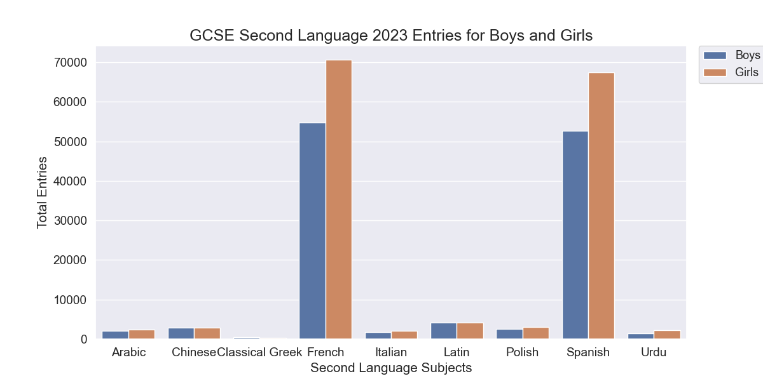
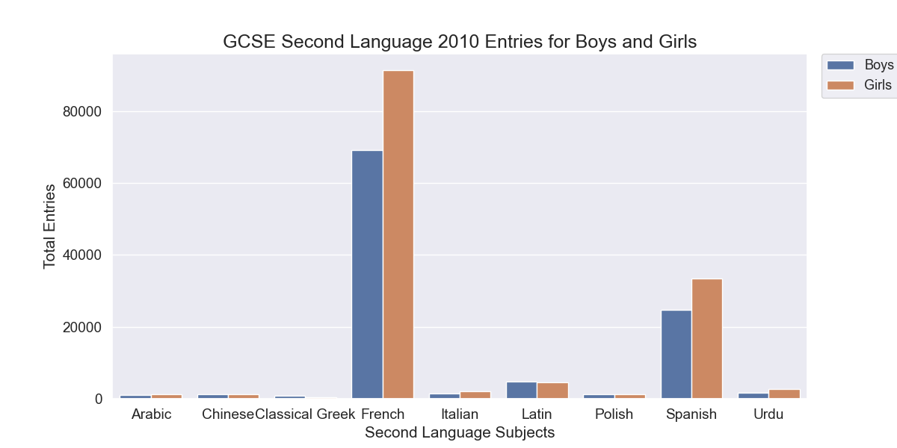
There's a notable increase in total exam entries for most language subjects from 2010 to 2022/23. This trend suggests a growing interest or requirement in studying second languages over the years.
In both years, for most languages, there's a disparity between boys' and girls' entries. For instance, in French and Spanish, girls consistently have more entries than boys in both years.
However, in some subjects like Arabic and Chinese, while girls had more entries in 2010, the scenario flipped, and boys had more entries in 2022/23.
French and Spanish, entries increased for both genders but maintained a similar gender ratio in both years.
Polish and Urdu, both languages saw an increase in entries for both genders, with girls having more entries in both years.
We can see in some languages showed fluctuations in gender-specific entries. For example, Arabic and Chinese had shifts in which gender had higher entries between the two years.
In subjects like Italian, there was a slight increase in entries, but the gender disparities remained somewhat consistent.
Changes in curriculum requirements, cultural shifts, and global economic trends might have influenced the interest and uptake of certain languages.

Slide 27
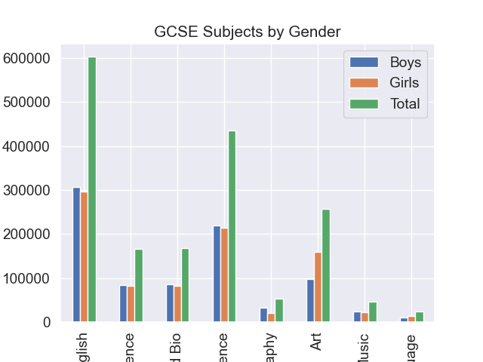
Subjects like Math and English, Triple Science, and Combined Science witness substantial participation from both genders, indicating a balanced interest in these fields.
Boys seem to exhibit more interest compared to girls in this subject.
These subjects demonstrate a significant disparity in participation, with higher entries from girls, especially in Art and Music.
Across several subjects like Math and English, Science, and Language, there seems to be a relatively balanced participation rate between genders.
Certain subjects, particularly Art, Music, and to some extent History and Geography, display a noticeable gender skew in participation, favouring girls in these disciplines.

Slide 28
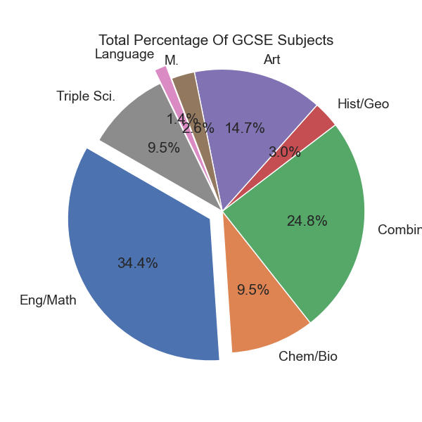
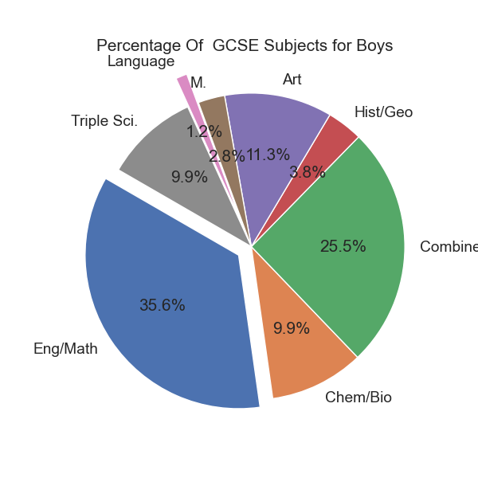
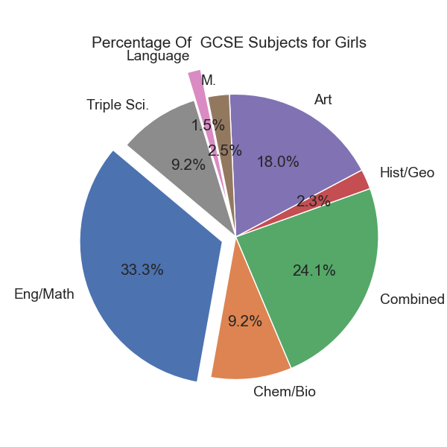
For Both GCSE Subjects by Gender Chart;
Both genders share similarities in preferences for Eng/Math, Chem/Bio, and Triple Sci subjects. Also, It shows near-equal participation between boys and girls. These subjects seem to attract students regardless of gender stereotypes or biases.
Girls show a significantly higher interest (49.1%) compared to boys (28.3%), indicating a potential inclination towards more creative and expressive fields among girls.
Boys exhibit a notably higher interest (9.4%) compared to girls (6.2%), suggesting a potential preference for social sciences or historical narratives among boys.
While both genders show low participation, girls slightly surpass boys (4.2% vs. 3.0%), indicating a slightly higher interest in language studies among girls.
Both genders show significant interest, but girls slightly edge out boys (66.0% vs. 63.6%), indicating a broader participation in this field among girls.
The percentage of GCSE subjects pie chart illustrates the percentage breakdown of subject choices among GCSE students. Each slice of the pie represents a different subject category, and the size of each slice corresponds to the proportion of students opting for that particular subject.
The largest portion of the pie, comprising nearly 90%, represents students choosing either English or Mathematics subjects.
Around a quarter of students opt for Chemistry or Biology subjects.
Approximately two-thirds of students choose Combined Science.
A smaller proportion, close to 8%, prefer History or Geography subjects.
Subjects like Art, Modern Languages, and Triple Science have comparatively lower percentages, each accounting for less than 40%, 10%, and 25% respectively.

